Slide 1
Section 2. Selecting a Chart Type
Lection 4. column & bar charts, linear & area diagrams

Slide 2
General considerations on Chart selections
Data type
a bar or column chart is often an appropriate chart when we are summarizing data about categories.
The relationship between two quantitative variables often makes a scatter chart an appropriate choice.
Bar charts, scatter charts, and line charts with the horizontal axis being time, are often the best choice for time series data.
If your data have a spatial component, a geographic map might be a good choice.
the goal
Explaining: the message that wish to convey
Exploring: the question you are asking
Common goals for charts are to show:
Composition—make up the whole of an entity.
Ranking— the relative order of items.
Correlation/Relationship— how two variables are related to one another.
Distribution— is how items are dispersed.
Creating great data visualizations is a skill that is best learned by doing

Slide 3
Horizontal bar charts show rank well by ordering bars from largest to smallest.
Line charts convey a change over a specified period of time, such as the unemployment rate per month over a 12-month period.
Point maps effectively demarcate precise locations, such as the address of each public school in a district.
Filled or choropleth maps allow for the comparison of regions, such as the GDP of each African country. Each region is filled with a shade. The darker the shade the higher the value.

Slide 5
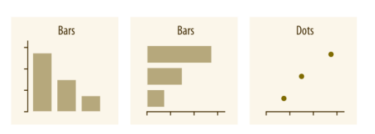
Amounts
The most common approach to visualizing amounts (i.e., numerical values shown for some set of categories) is using bars, either vertically or horizontally arranged (Chap‐ ter 6). However, instead of using bars, we can also place dots at the location where the corresponding bar would end (Chapter 6).

Slide 6
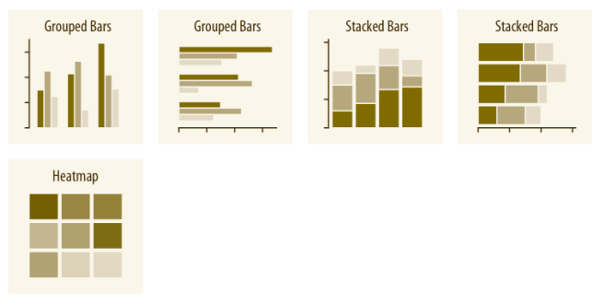
If there are two or more sets of categories for which we want to show amounts, we can group or stack the bars (Chapter 6). We can also map the categories onto the x and y axes and show amounts by color, via a heatmap (Chapter 6).

Slide 7
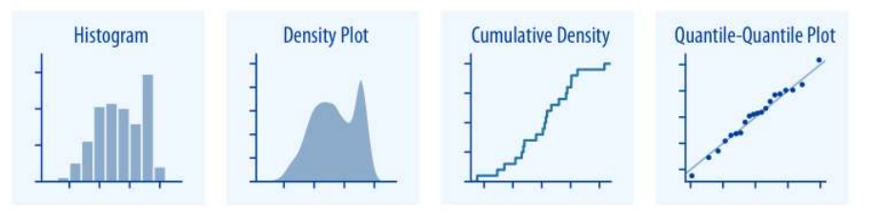
Distributions
Histograms and density plots (Chapter 7) provide the most intuitive visualizations of a distribution, but both require arbitrary parameter choices and can be misleading. Cumulative densities and quantile-quantile (q-q) plots (Chapter 8) always represent the data faithfully but can be more difficult to interpret.

Slide 8
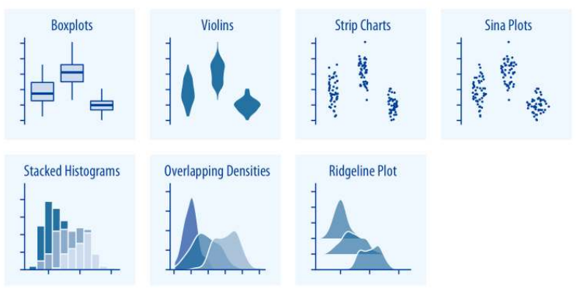
Boxplots, violin plots, strip charts, and sina plots are useful when we want to visualize many distributions at once and/or if we are primarily interested in overall shifts among the distributions (see “Visualizing Distributions Along the Vertical Axis” on page 81). Stacked histograms and overlapping densities allow a more in-depth com‐ parison of a smaller number of distributions, though stacked histograms can be diffi‐ cult to interpret and are best avoided (see “Visualizing Multiple Distributions at the Same Time” on page 64). Ridgeline plots can be a useful alternative to violin plots and are often useful when visualizing very large numbers of distributions or changes in distributions over time (see “Visualizing Distributions Along the Horizontal Axis” on page 88).

Slide 9
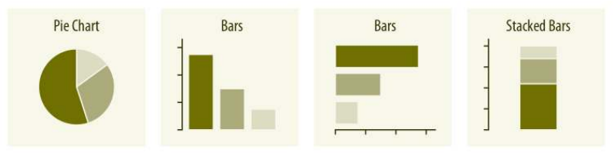
Proportions
Proportions can be visualized as pie charts, side-by-side bars, or stacked bars (Chap‐ ter 10). As for amounts, when we visualize proportions with bars, the bars can be arranged either vertically or horizontally. Pie charts emphasize that the individual parts add up to a whole and highlight simple fractions. However, the individual pieces Proportions | 39 are more easily compared in side-by-side bars. Stacked bars look awkward for a single set of proportions, but can be useful when comparing multiple sets of proportions

Slide 10
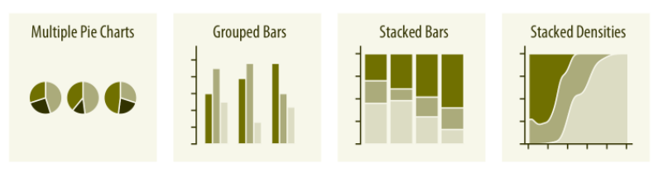
When visualizing multiple sets of proportions or changes in proportions across con‐ ditions, pie charts tend to be space-inefficient and often obscure relationships. Grou‐ ped bars work well as long as the number of conditions compared is moderate, and stacked bars can work for large numbers of conditions. Stacked densities (Chap‐ ter 10) are appropriate when the proportions change along a continuous variable.

Slide 11
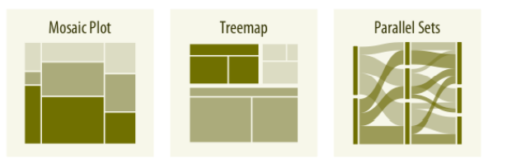
When proportions are specified according to multiple grouping variables, mosaic plots, treemaps, or parallel sets are useful visualization approaches (Chapter 11). Mosaic plots assume that every level of one grouping variable can be combined with every level of another grouping variable, whereas treemaps do not make such an assumption. Treemaps work well even if the subdivisions of one group are entirely distinct from the subdivisions of another. Parallel sets work better than either mosaic plots or treemaps when there are more than two grouping variables.

Slide 12
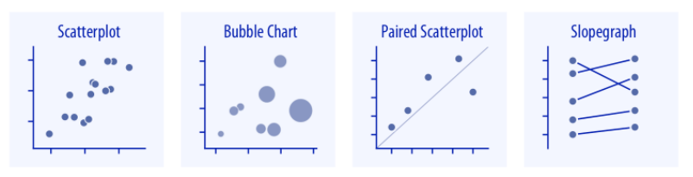
x–y relationships
Scatterplots (Chapter 12) represent the archetypical visualization when we want to show one quantitative variable relative to another. If we have three quantitative vari‐ ables, we can map one onto the dot size, creating a variant of the scatterplot called a bubble chart. For paired data, where the variables along the x and y axes are meas‐ ured in the same units, it is generally helpful to add a line indicating x = y (see “Paired Data” on page 127). Paired data can also be shown as a slopegraph of paired points connected by straight lines.

Slide 13
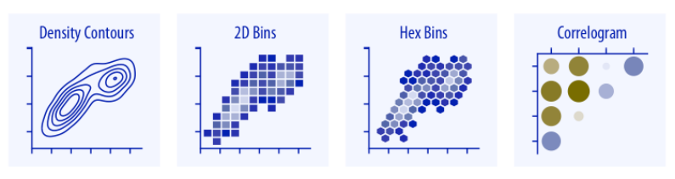
For large numbers of points, regular scatterplots can become uninformative due to overplotting. In this case, contour lines, 2D bins, or hex bins may provide an alterna‐ tive (Chapter 18). When we want to visualize more than two quantities, on the other hand, we may choose to plot correlation coefficients in the form of a correlogram instead of the underlying raw data (see “Correlograms” on page 121).

Slide 14
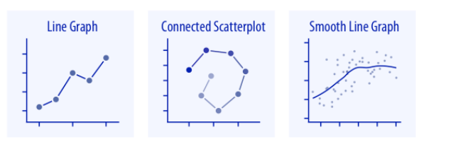
When the x axis represents time or a strictly increasing quantity such as a treatment dose, we commonly draw line graphs (Chapter 13). If we have a temporal sequence of two response variables we can draw a connected scatterplot, where we first plot the two response variables in a scatterplot and then connect dots corresponding to adja‐ cent time points (see “Time Series of Two or More Response Variables” on page 138). We can use smooth lines to represent trends in a larger dataset (Chapter 14).

Slide 15
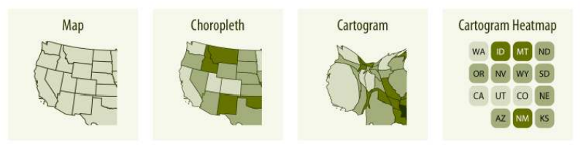
Geospatial Data
The primary mode of showing geospatial data is in the form of a map (Chapter 15). A map takes coordinates on the globe and projects them onto a flat surface, such that shapes and distances on the globe are approximately represented by shapes and dis‐ tances in the 2D representation. In addition, we can show data values in different regions by coloring those regions in the map according to the data. Such a map is called a choropleth (see “Choropleth Mapping” on page 172). In some cases, it may be helpful to distort the different regions according to some other quantity (e.g., popula‐ tion number) or simplify each region into a square. Such visualizations are called car‐ tograms (see “Cartograms” on page 176).

Slide 16
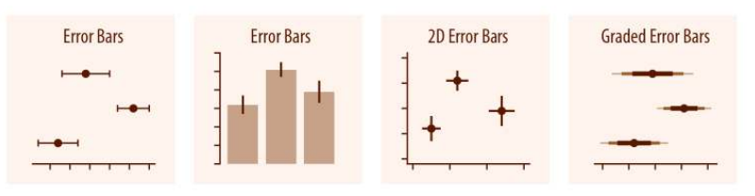
Uncertainty
Error bars are meant to indicate the range of likely values for some estimate or meas‐ urement. They extend horizontally and/or vertically from some reference point rep‐ resenting the estimate or measurement (Chapter 16). Reference points can be shown in various ways, such as by dots or by bars. Graded error bars show multiple ranges at the same time, where each range corresponds to a different degree of confidence. They are in effect multiple error bars with different line thicknesses plotted on top of each other.

Slide 17
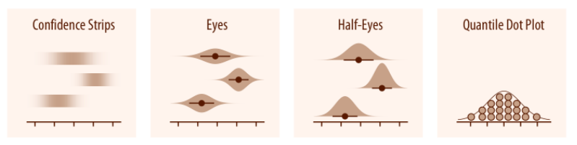
To achieve a more detailed visualization than is possible with error bars or graded error bars, we can visualize the actual confidence or posterior distributions (Chap‐ ter 16). Confidence strips provide a visual sense of uncertainty but are difficult to read accurately. Eyes and half-eyes combine error bars with approaches to visualize distributions (violins and ridgelines, respectively), and thus show both precise ranges for some confidence levels and the overall uncertainty distribution. A quantile dot plot can serve as an alternative visualization of an uncertainty distribution (see “Framing Probabilities as Frequencies” on page 181). Because it shows the distribu‐ tion in discrete units, the quantile dot plot is not as precise but can be easier to read than the continuous distribution shown by a violin or ridgeline plot.

Slide 18
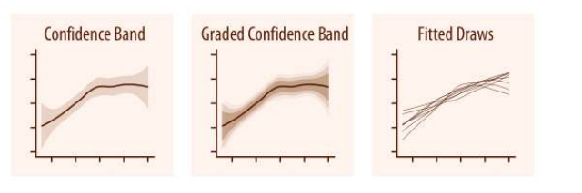
For smooth line graphs, the equivalent of an error bar is a confidence band (see “Vis‐ ualizing the Uncertainty of Curve Fits” on page 197). It shows a range of values the line might pass through at a given confidence level. Like with error bars, we can draw graded confidence bands that show multiple confidence levels at once. We can also show individual fitted draws in lieu of or in addition to the confidence bands.

Slide 19
Visualizing Amounts

Slide 20
Bar Plots

